Slide 1


Slide 2
About Today…
Authentication
Passport.js

Slide 3
Implementing authentication with

Slide 4
Intro to User Authentication
Definition
The process of verifying the identity of a user trying to access a system
Importance
Security
Ensures that only authorized users can access the system, protecting sensitive data
Personalization
Allows for personalized user experiences, such as user-specific settings and content
Tracking
Enables tracking of user actions for analytics and auditing purposes
Real-world Examples
Logging into a website like Facebook or Gmail
Accessing banking applications with a username and password

Slide 5
Overview of Passport.js
Definition
Passport.js is an authentication middleware for Node.js, designed to simplify the process of authenticating requests
Features
Simple and Unobtrusive
Minimal code needed to implement
Modular and Flexible
Can be extended with various strategies (e.g., Local, OAuth, JWT)
Wide Support
Many third-party strategies available for integration with services like Google,
Facebook, and GitHub
Official Website
http://www.passportjs.org/

Slide 6
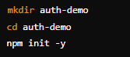
Setting Up Your Project
Initialize a new Node.js project
This creates a new directory for your project and initializes it with a package.json file
Install necessary packages
express
Framework for building web applications
express-session
Middleware for handling session data
passport
Authentication middleware
passport-local
Strategy for local authentication using
a username and password
bcryptjs
Library for hashing passwords securely

Slide 7
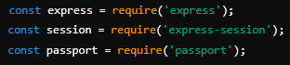
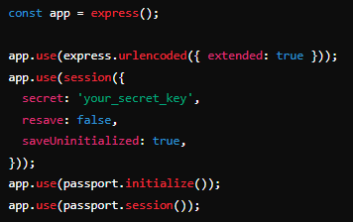
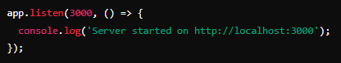
Basic Express Server Setup
Code
Explanation
express.urlencoded({ extended: true })
Middleware to parse URL-encoded bodies (from form submissions)
express-session
Middleware to handle user sessions
passport.initialize()
Initializes Passport for use
passport.session()
Middleware to handle user sessions

Slide 8
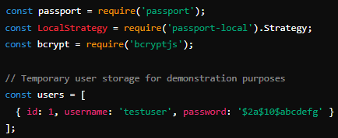
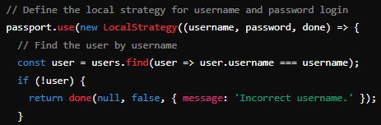
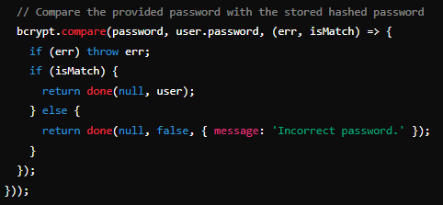
Configuring Passport.js
1
Code
2
3
Local Strategy
Handles login using username & password
bcrypt
Compare provided password with stored one
passport.use()
Sets up the local strategy for authentication
Finding User
Searches user in temporary user storage by
username
Password Comparison
Uses bcrypt to check if the provided
password matches the stored hashed password

Slide 9
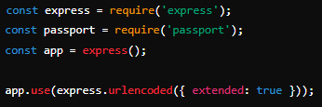
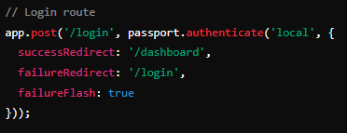
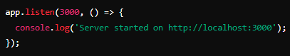
Implementing Login Route
Code
Login Route
‘/login’ handles user login using Passport's local strategy
passport.authenticate('local')
Middleware that uses the local strategy for authentication
Redirection
Redirects the user to ‘/dashboard’ on success or ‘/login’ on failure

Slide 10
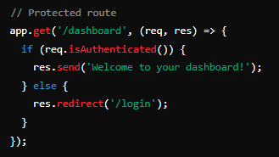
Dashboard Route
Code
Protected Route
‘/dashboard’ is only accessible if the user is authenticated
req.isAuthenticated()
Checks if the user is authenticated

Slide 11

What is Passport.js used for in a Node.js application?
Passport.js is used for handling authentication in a Node.js application
What does the LocalStrategy in Passport.js handle?
The LocalStrategy handles authentication using a username and password
Which library is used to compare hashed passwords in Passport.js?
The bcryptjs library is used to compare hashed passwords
What function in Passport.js sets up the authentication strategy?
The passport.use() function sets up the authentication strategy
What happens when the passport.authenticate('local') middleware successfully authenticates a user?
The user is redirected to the specified success route (e.g., /dashboard)

Slide 12

Task
Create an express app to use passport.js in the app for authentication

